Slide 1
Course Capstone
Data Collection
09th October, 2025

Slide 2
Finding the Middle of Clicks
Mean, Median, and Mode help in compare the data. Below, list the mean, median, and mode of the clicks in the “Facebook Ad” & “AdWords Ad” data.
Facebook Ad |  | AdWords Ad
Mean (Clicks) | 44.05 | Mean (Clicks) | 60.38
Median (Clicks) | 43.00 | Median (Clicks) | 60.00
Mode (Clicks) | 36.00 | Mode (Clicks) | 78.00

Slide 3
Finding the Middle of Conversions
Mean, Median, and Mode help in compare the data. Below, list the mean, median, and mode of the conversions in the “Facebook Ad” & “AdWords Ad” data.
Facebook Ad |  | AdWords Ad
Mean (Conversions) | 11.74 | Mean (Conversions) | 5.98
Median (Conversions) | 12.00 | Median (Conversions) | 6.00
Mode (Conversions) | 13.00 | Mode (Conversions) | 5.00

Slide 4
Standard Deviation
Determining variance in data helps show how spread out the values are around the mean. Below, is the standard deviation of the “Facebook Ad” & “AdWords Ad data.
Facebook Ad |  | AdWords Ad
Standard Deviation (Clicks) | 12.14 | Standard Deviation (Clicks) | 14.38
Standard Deviation (Conversions) | 2.92 | Standard Deviation (Conversions) | 1.63

Slide 5
Frequency Table of Facebook
Understanding how often something happens is important to understanding trends and patterns in your data. Create and insert a contingency table generated from your data.
 | Number of “Facebook” Conversions by Grouping for 2023
Number of Conversions: | 1 to 5 | 6 to 10 | 11 to 15 | 16+
Number of Occurrences: | 1 | 128 | 189 | 47

Slide 6
Frequency Table of AdWords
Understanding how often something happens is important to understanding trends and patterns in your data. Create and insert a contingency table generated from your data.
 | Number of “AdWords” Conversions by Grouping for 2023
Number of Conversions: | 1 to 5 | 6 to 10 | 11 to 15 | 16+
Number of Occurrences: | 155 | 209 | 0 | 0

Slide 7
Contingency Table of Facebook
Understanding how often something happens is important to understanding trends and patterns in your data. Create and insert a contingency table generated from your data.
Facebook Ad Clicks vs. Conversions (2023)
 | Low Clicks (1–30) | Medium Clicks (31–50) | High Clicks (51+) | Total
Low Conversions (1–5) | 1 | 0 | 0 | 1
Medium Conversions (6–10) | 47 | 81 | 0 | 128
High Conversions (11–15) | 2 | 107 | 80 | 189
Very High Conversions (16+) | 0 | 0 | 47 | 47
Total | 50 | 188 | 127 | 365

Slide 8
Contingency Table of AdWords
Understanding how often something happens is important to understanding trends and patterns in your data. Create and insert a contingency table generated from your data.
AdWords Ad Clicks vs. Conversions (2023)
 | Low Clicks (1–30) | Medium Clicks (31–50) | High Clicks (51+) | Total
Low Conversions (1–5) | 0 | 68 | 87 | 155
Medium Conversions (6–10) | 0 | 40 | 169 | 209
High Conversions (11–15) | 0 | 0 | 0 | 0
Very High Conversions (16+) | 0 | 0 | 0 | 0
Total | 0 | 108 | 256 | 364

Slide 9
Scatter Plot of Facebook Ad
Correlation coefficient: 0.873775015
Insights:
Strong positive correlation shows clicks reliably drive conversions
Clear upward trend indicates predictable return on ad spend
Efficient platform worthy of increased investment

Slide 10
Scatter Plot of AdWords Ad
Correlation coefficient: 0.447993201
Insights:
Weak positive correlation reveals poor click-to-conversion relationship
High clicks often fail to generate proportional conversions
Needs strategic optimization before budget expansion

Slide 11
End of Module 1

Slide 12
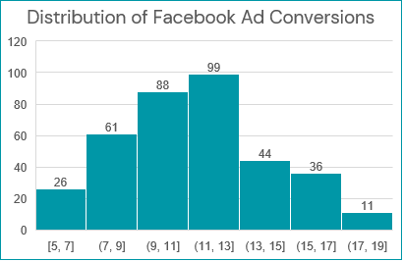
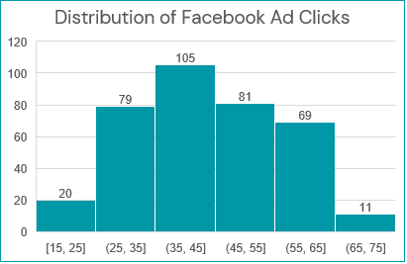
Sample Type of Facebook Ad
Bucket Size: 10
Distribution (Clicks): Normal
Bucket Size: 2
Distribution (Conversions): Normal

Slide 13
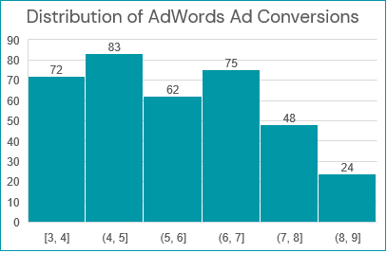
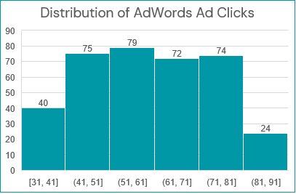
Sample Type of AdWords Ad
Bucket Size: 10
Distribution (Clicks): Normal
Bucket Size: 1
Distribution (Conversions): Normal

Slide 14
Variable Types
Quantitative | Continuous | Cost per Facebook Ad Facebook Click-Through Rate (Clicks / Views) Facebook Conversion Rate (Conversions / Clicks) Facebook Cost per Click (Ad Cost / Clicks) Cost per AdWords Ad AdWords Click-Through Rate (Clicks / Views) AdWords Conversion Rate (Conversions / Clicks) AdWords Cost per Click (Ad Cost / Clicks)
 | Discrete | Facebook Ad Views Facebook Ad Clicks Facebook Ad Conversions AdWords Ad Views AdWords Ad Clicks AdWords Ad Conversions
Qualitative: | Nominal | Facebook Ad Campaign AdWords Ad Campaign
 | Ordinal | Date

Slide 15
End of Module 2

Slide 16
Research Question & Hypothesis
Research Question | Is there a difference between the number of conversions on the Facebook platform versus the AdWords platform?
Hypothesis | The number of conversions will be higher on the Facebook platform compared to the AdWords platform due to differences in platform engagement and ad targeting efficiency.
Hypothesis Breakdown | What will change? | The number of ad conversions.
 | How will it change? | The number of conversions will be higher on Facebook compared to AdWords.
 | What will cause the change? | The difference in advertising platforms (Facebook vs. AdWords).

Slide 17
Variable Types & Mean Conversions
Variable Type | Variable Name | Description
Independent Variable | Advertising Platform | The platform where the ads are run (Facebook or AdWords).
Dependent Variable | Number of Conversions | The number of conversions resulting from ads on each platform.
Platform | Mean | Median | Standard Deviation
Facebook Ads | 11.74 | 12.00 | 2.92
AdWords Ads | 5.98 | 6.00 | 1.63

Slide 18
Hypothesis Testing & Results
Null Hypothesis (H₀) | There is no difference between Facebook and AdWords Ad Conversions.
Alternative Hypothesis (H₁) | There is a difference between Facebook and AdWords Ad Conversions.
Test | p-value | Alpha (α) | Decision
Two-sample t-test | 1.20E-133 | 0.05 | Reject H₀
Conclusion:
Since p < 0.05, there is a statistically significant difference between Facebook and AdWords Ad Conversions.
This supports the Alternative Hypothesis (H₁).
Facebook Ads generate significantly higher conversions on average than AdWords Ads.

Slide 19
End of Module 3

Slide 20
Determining a Model
Based off what you know so far, you’ll need to determine if your data meets the assumptions for a chosen model. Including:
Which model makes the most sense to use and why?

Slide 21
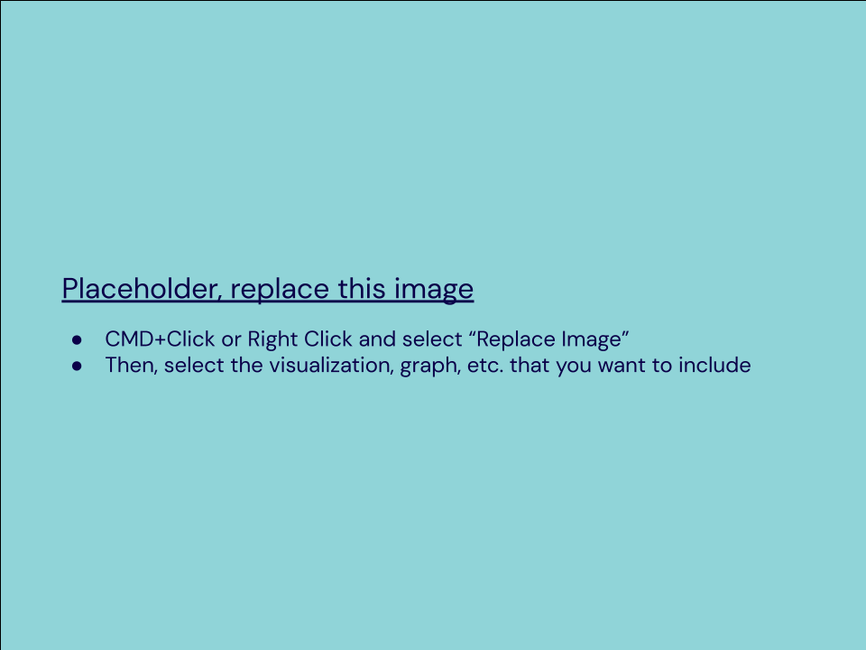
Modeling
Finally, include a visualization of your complete model.

Slide 22
End of Module 4

Slide 23
Final Insights
Now, knowing what you do about the results of your test, what are the final insights that you would share with your client? What did you learn and what would you recommend? Is there anything you would do differently next time?
Enter your insights here:

